Slide 1

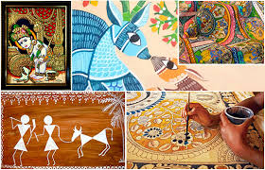
ARTWORK STYLE
Recognition & Recommendation System
PRESENTED BY : NIKITA DAS BIPLAB KAR
SHREYAN BHATTACHARJEE

Slide 2
Presentation Topics
Business Problem
The Analytics challenge
Business Data
Data Issues & Data Security
Modeling & Evaluation
Deploying
Challenges & Mitigation
Keeping ahead of Competition
Learnings & next steps

Slide 3
ANALYTICS CHALLENGE
The domain of "Art and Technology." This is a highly relevant and important domain with various impacts on the art world and
society as a whole. Here's an overview of the importance, impact, leaders, and how they maintain leadership in this domain:
This domain is essential for several reason :
Enhanced Artistic Expression with the help of technology.
Art Preservation
Art market and Commerce.
Art Education and Engagement.
Impact of the domain:
Artistic innovation
Global reach and Culture Preservation
Economic impact
Leaders in the Domain of Art and Technology:
Art Institutions
Tech Companies
Art Tech Startups.
Leaders in the domain of art and technology maintain their positions through various strategies:
✓
✓
✓
Innovation Collaborations Education and outreach

Slide 4
BUSINESS PROBLEM
We are developing a machine learning system that can recognise the style or genre of visual art works and recommend similar pieces and artists to other users. This project can encompass various forms of visual art, paintings , sculptures, photography and more .
The subjectivity of art , its interdisciplinary nature, historical significance and intellectual property consideration makes my project unique and authentic .
Personalized Art Curation: There are difficulties for art enthusiasts , in discovering new artworks that
match their preferred style, leading to decrease user engagement and potential revenue loss for art platforms , galleries, museums and many more.
Art Sales and E-commerce:
Business Problem: Lower sales due to online art marketplaces struggling to guide customers to artworks they like, resulting in reduced revenue and user satisfaction.
Auction Houses and Pricing:
Business Problem: Challenges in estimating the value of artworks for auction and setting reserve prices, which can affect the success of auctions and revenue.
Brand Marketing and Design:
Business Problem: Difficulty in identifying art styles that align with a company's brand and
design preferences, which can impact marketing and design strategies.

Slide 5
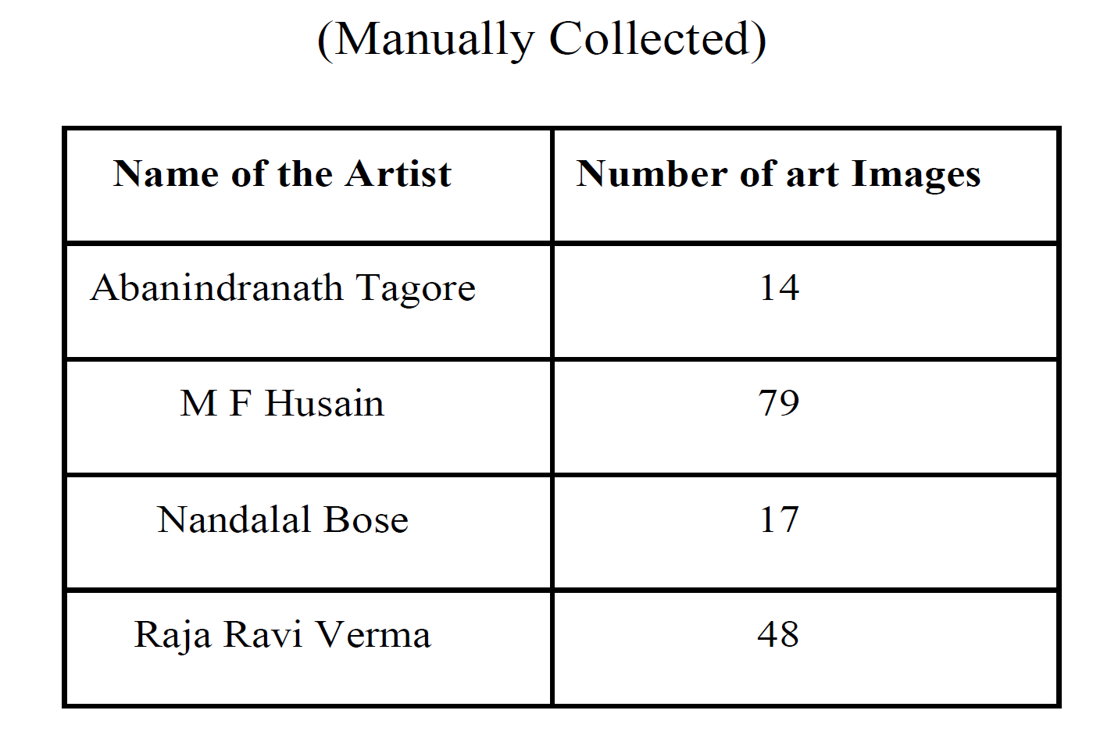
BUSINESS DATA
Art Databases and Museums:
Government and Cultural Agencies.
Open Access Art Datasets.
This dataset contains three folders:
train (130 images each)
test (13 images each)
validation (13 images each)
Challenges to solve while collecting data:
Limited Access to Institutional Data
Some art styles and artists are less well-known and have limited representation in data sources. Recognizing and recommending these less common styles can be challenging.
Collecting and curating a high-quality art dataset can be expensive in terms of both time and
resources.
Metadata for artworks, such as artist names, titles, and styles, can be inconsistent across different
sources.

Slide 6
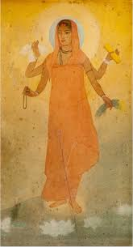
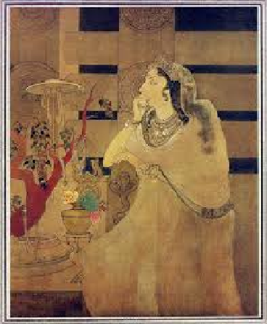
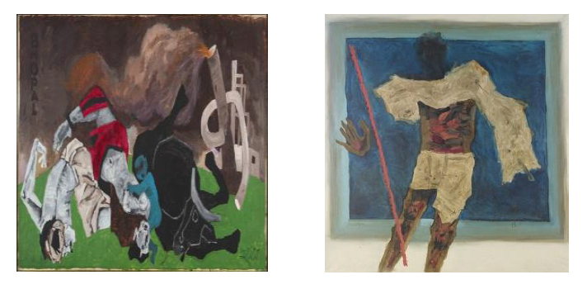
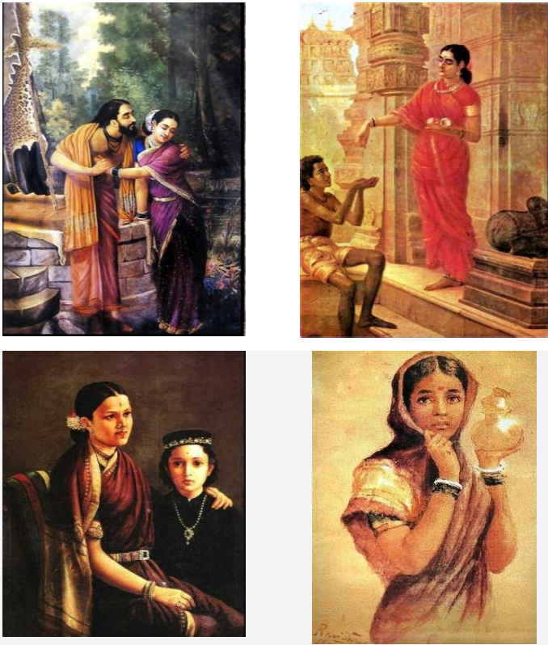
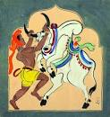
Sample Artwork
MF Hussian
Bharat Mata
Asoka’s Queen
Abanindranath Tagore
Raja Ravi Verma
Nandalal Bose

Slide 7
Potential Data Issues including Security
Unauthorized Access
Data Breaches
Copyright and Intellectual Property
Data Encryption
Secure Storage
Data Anonymization and De-Identification
Data Transmission Security
Insider Threats
Ethical Considerations
Compliance with Data Protection Regulations
Secure Collaboration
Periodic Security Audits
Secure Authentication
Employee Training

Slide 8
Modelling & Evaluation
DATA PREPROCESSING
FEATURE EXTRACTION
MODEL SELECTION
MODEL EVALUATION
MODEL TRAINING
MODEL ARCHITECTURE
MODEL TESTING
MODEL OPTIMISATION
DEPLOYMENT

Slide 9
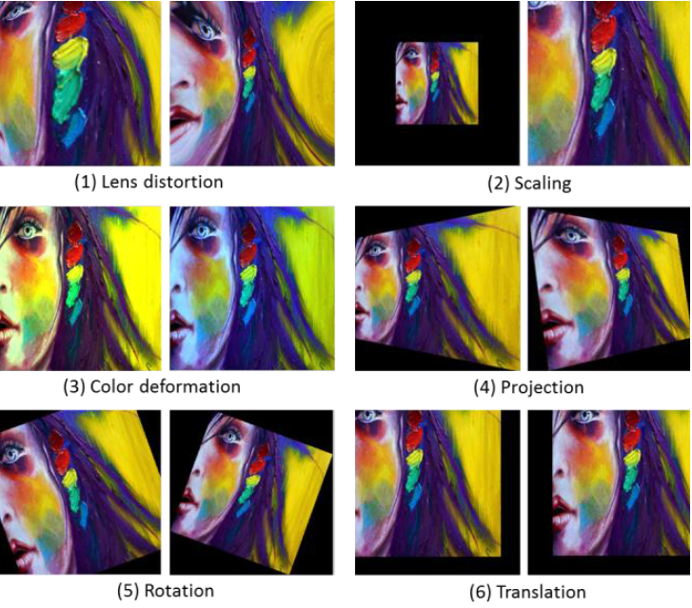
Deployment
Overall Process of Image Distortion
Input Image
Lens Distortion
Scaling
Colour Variation
Operating in Random Order
Distorted
Image
Projection
Rotation
Translation

Slide 10
Challenges & Mitigation
Challenges:
Variability in Art Styles: Art styles can be highly diverse and may not have clear boundaries. Some styles might evolve over time, and artists can mix elements from different styles.
Mitigation: Use a diverse dataset that includes a wide range of art styles. Fine-tune models on specific styles or substyles to capture their nuances.
Data Availability: There may be limited data available for some art styles, especially lesser-known or niche styles.
Mitigation: Augment the dataset using data generation techniques, such as style transfer, and transfer learning from larger, more diverse art datasets.
Ambiguity: Art style recognition can be subjective, and different experts may have varying opinions on the same artwork's style.
Mitigation: Consider using crowdsourced or expert-annotated labels to handle subjectivity and reach a consensus on the style.
Intra-Class Variability: Art styles can have significant intra-class variability. For example, Impressionism includes a wide range of artwork, from landscapes to portraits.
Mitigation: Utilize hierarchical or fine-grained classification models to recognize substyles within broader categories.
Limited Training Data: Deep learning models often require a large amount of data to perform well. Some art styles may have very few examples.
Mitigation: Utilize techniques like data augmentation, few-shot learning, and transfer learning from related styles or from general image recognition tasks.

Slide 11

Keeping ahead of Competition
Invest in Hardware: Stay updated with the latest advancements in hardware that can accelerate model training and deployment. GPUs, TPUs, and other specialized hardware can significantly boost performance.
Cross-Disciplinary Knowledge: Gain insights from other fields like neuroscience, psychology, and cognitive science to enhance your understanding of how humans think and learn, which can influence model design.
AI Ethics and Bias Mitigation: Develop models that are fair and unbiased, addressing concerns about algorithmic discrimination and ethical use of AI.
Interdisciplinary Teams: Build diverse teams that bring different perspectives to AI development. Cross-functional teams with varied skills can lead to more innovative solutions.
Patents and Intellectual Property: Protect your intellectual property with patents if applicable, and ensure that you are compliant with copyright laws.
Market Research: Continuously analyze the market to understand evolving customer needs and identify potential gaps in the competitive landscape.
Thought Leadership: Establish yourself and your organization as thought leaders in AI through publications, speaking engagements, and contributions to the AI community.
Adapt to New Technologies: Embrace new programming languages, frameworks, and tools that can improve your workflow and model development.
Network: Attend conferences, seminars, and workshops to network with peers and experts in the AI community. Building a strong professional network can lead to valuable collaborations and insights.
Risk-Taking: Be open to calculated risks and explore unconventional ideas. Sometimes, groundbreaking innovations come from taking bold steps.

Slide 12
Learnings & future plan
Improved Accuracy: Continuous learning involves updating the model's architecture and training data to improve accuracy in recognizing and classifying different art styles, artists, and artworks.
Expanded Datasets: Models can benefit from larger and more diverse art datasets, which will help them recognize a wider range of styles, artists, and artistic movements.
Style Evolution Understanding: Future models may be designed to understand how art styles evolve over time and adapt to capture these changes.
Interdisciplinary Knowledge: Learning from related fields, such as art history and cultural studies, can help models gain a deeper understanding of the context and meaning of artworks, leading to better recommendations.
Multimodal Analysis: Incorporating image and text analysis together can provide a more comprehensive understanding of artworks, artist biographies, and historical context.
Personalization: Customizing recommendations based on individual preferences and browsing history to provide a more tailored experience for users.
Mobile and AR Integration: Integrating these models into mobile apps or augmented reality (AR) platforms for on-the-go art recognition and recommendations.
Cross-Cultural and Multilingual Support: Expanding recognition and recommendation capabilities to encompass art from diverse cultures and languages, enhancing inclusivity.
Art Market Insights: Providing users with information about the art market, such as current values, auctions, and trends.
Collaborative Filtering: Incorporating collaborative filtering methods to make recommendations based on users' profiles and preferences, similar to how platforms like Netflix recommend movies.

Slide 13

Celebrate Your Worth
http://www.praxis.ac.in

